Slide 1

Simple rules for good research practice
Adrian Barnett, 29 November 2025
Queensland University of Technology
Photo by Bruno Mauricio on Unsplash

Slide 2
Current state of research
Correctable weaknesses in the design, conduct, and analysis of biomedical and public health research studies can produce misleading results and waste valuable resources. Small effects can be difficult to distinguish from bias introduced by study design and analyses. An absence of detailed written protocols and poor documentation of research is common. Information obtained might not be useful or important, and statistical precision or power is often too low or used in a misleading way. Insufficient consideration might be given to both previous and continuing studies. Arbitrary choice of analyses and an overemphasis on random extremes might affect the reported findings. Several problems relate to the research workforce, including failure to involve experienced statisticians and methodologists, failure to train clinical researchers and laboratory scientists in research methods and design, and the involvement of stakeholders with conflicts of interest. Inadequate emphasis is placed on recording of research decisions and on reproducibility of research. Finally, reward systems incentivise quantity more than quality, and novelty more than reliability.
DOI: 10.1016/S0140-6736(13)62227-8

Slide 3
Declaration of Helsinki
“Medical research involving human participants must have a scientifically sound and rigorous design and execution that are likely to produce reliable, valid, and valuable knowledge and avoid research waste. The research must conform to generally accepted scientific principles, be based on a thorough knowledge of the scientific literature, other relevant sources of information, and adequate laboratory and, as appropriate, animal experimentation.”
“Scientific integrity is essential in the conduct of medical research involving human participants. Involved individuals, teams, and organizations must never engage in research misconduct.”
Updated in 2024

Slide 4
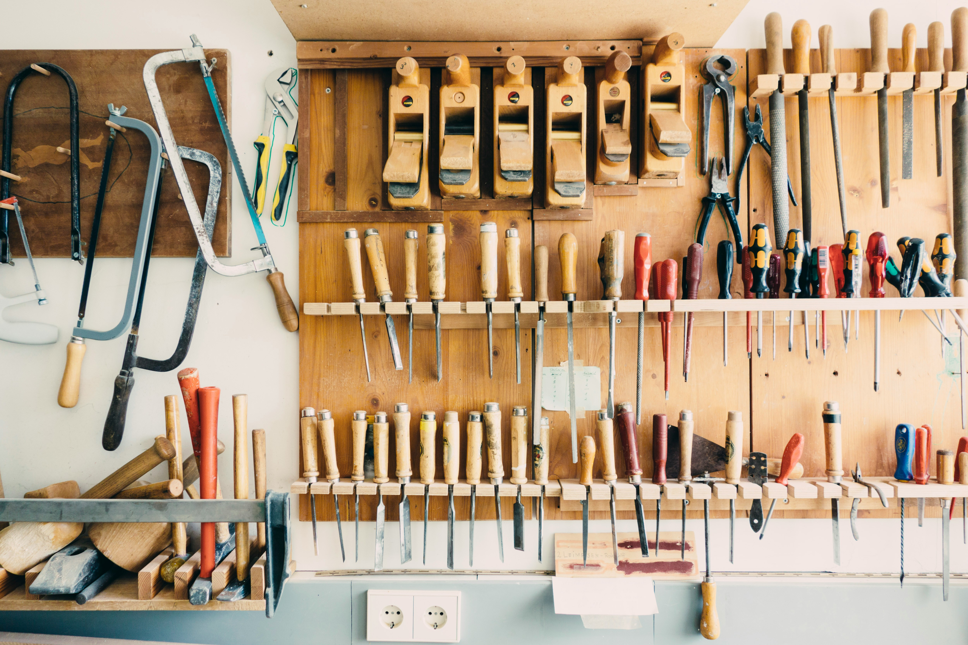
“There are only a handful of ways to do a study properly but a thousand ways to do it wrong”, David Sackett
Photo by Barn Images on Unsplash

Slide 5

COVID-19 saw an explosion in clinical prediction models, DOI: 10.1136/bmj.m1328
Many small studies
High risk of over-fitting: A good model for these data, but a bad model for new data.
Out of 600 models, only 6 were useful for policy
Photo by Mufid Majnun on Unsplash

Slide 6
Growth of paper mills
doi: https://doi.org/10.1101/2025.08.29.673016

Slide 7
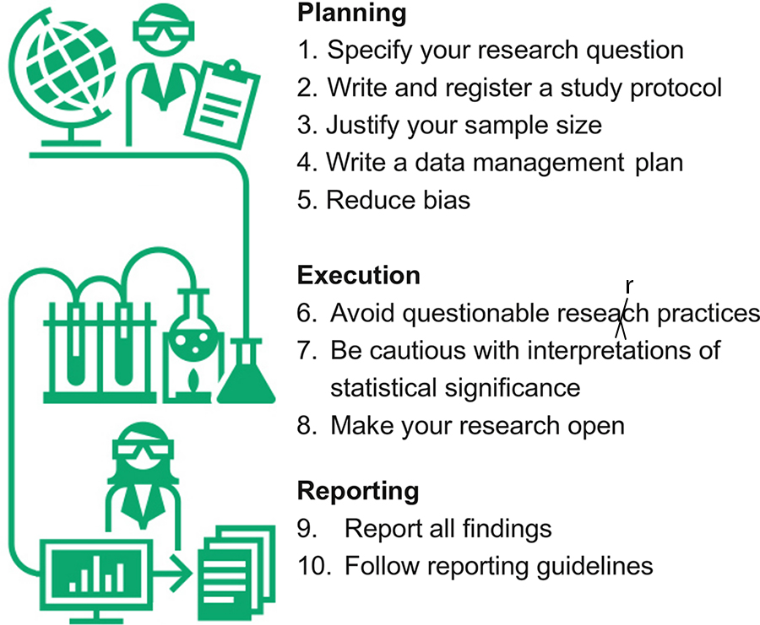
Ten simple rules for good research practice
DOI: 10.1371/journal.pcbi.1010139

Slide 8
Rule 1. Specifying questions
Two good examples of research questions:
Does a higher job satisfaction mean that nurses wash their hands more?
Does using a silver-coated dressing reduce wound infections in hospital compared with a standard dressing?
Bad example:
Does obesity shorten life?

Slide 9

PICOT for specifying questions
Study population “P”
Intervention “I”
Comparison or control “C”
Outcome “O”
Time “T”
Photo by Paul Hanaoka on Unsplash

Slide 10
Rule 1. Specifying questions
Does using a silver-coated dressing reduce wound infections in-hospital compared with a standard dressing?
Population = patients with a hospital infection
Intervention = silver-coated dressing
Comparison = standard dressing
Outcome = infections (cured or remaining)
Time = from infection to end of hospital stay?

Slide 11

Rule 1. Specifying questions
Should involve a lot of reading
Recent reviews are really helpful
You can re-use the good ideas from previous papers with acknowledgement and citation. You can’t plagiarise methods.
Photo by Patrick Tomasso on Unsplash

Slide 12

Rule 1. Specifying questions
Common mistake: Trying to answer 5 research questions in one study = 1 bad study
Remedy: Answer 1 to 2 research questions in 3 studies = 3 better quality studies
Go slower, reflect on past results to inform the next question
Photo by Jonathan Chng on Unsplash

Slide 13
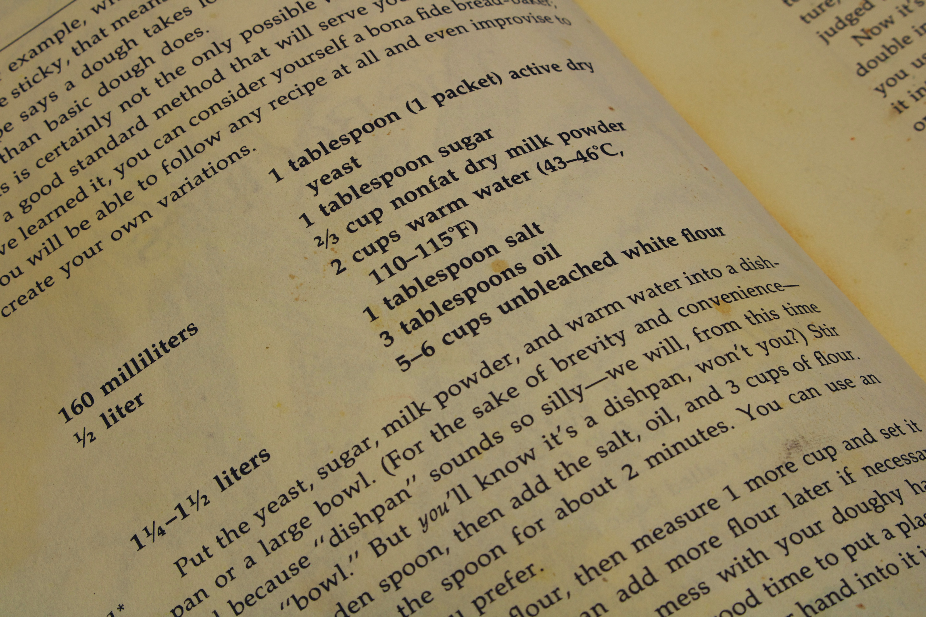
Rule 2. Write and register a study protocol
The research question and hypothesis
A description of the population
The target sample size
The inclusion/exclusion criteria
The study design, e.g., randomised trial
The data collection
The data processing and transformation
The planned statistical analyses
Photo by James Lee on Unsplash

Slide 14
Rule 2. Write and register a study protocol
More thought before starting will always lead to a better study
Consider everything that could go wrong
Makes writing the paper much easier
Can publish a protocol online for no cost, e.g., with the Open Science Framework (www.osf.io)

Slide 15
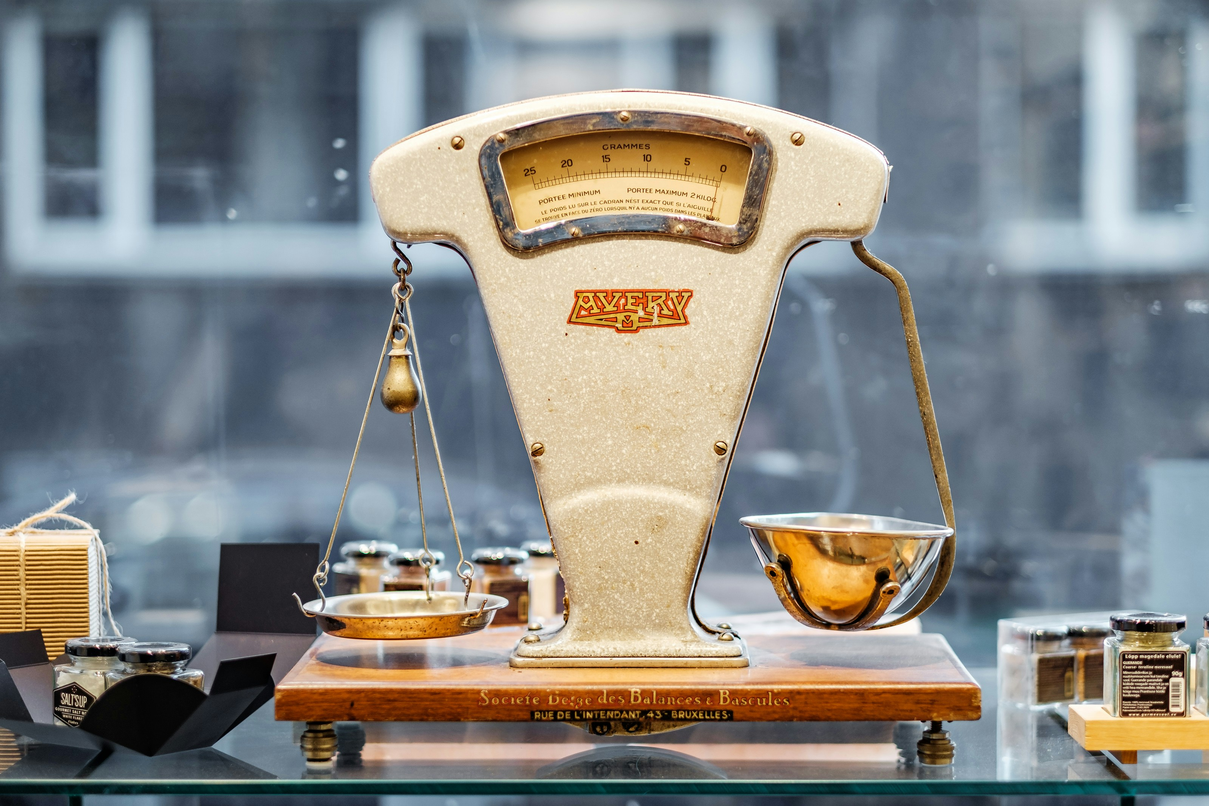
Rule 3. Justify your sample size
How many people/participants/patients we need to answer our research question
Sufficiently large to have reasonable chance of answering the research question
Have smallest possible costs in terms of: Money, Delayed decision, Participant time, Your time (opportunity costs)
Photo by Piret Ilver on Unsplash

Slide 16
Rule 3. Justify your sample size

Slide 17

Rule 4. Write a data management plan
Without high quality data, the whole study can be pointless
Recent mistakes: ethnicity (categorical) treated as continuous, and month of the year (circular) treated as linear
Beware of Excel! https://doi.org/10.1080/00031305.2017.1375989
Create a data dictionary
Not exciting but is important
Photo by Sander Sammy on Unsplash

Slide 18
Rule 5: Reduce bias
Bias creates a systematic difference between the truth and your data
Avoid leading questions in surveys, e.g., Q: How well do you feel today? A: Excellent, really well, unwell.
Reduce missing data, e.g., participants in a drug trial often get an allergic reaction and drop-out, could create false differences between the treatment and control group
Confounding, where another variable is the real cause, e.g., coffee drinkers often also smoke, which can make coffee appear associated with lung cancer

Slide 19

Rule 6: Avoid questionable research practices
P-hacking = re-analysing data until a “significant” result is achieved
Selective reporting = leaving out unfavourable results
Spin = writing up results in a too favourable light
Salami slicing = publishing one result in multiple papers to boost your metrics
Selective citation = not citing relevant work to look more original
HARKing = pretending the research question was generated in advance rather than being found in exploratory analyses
Photo by Markus Spiske on Unsplash

Slide 20


Rule 7. Be cautious with interpretations of statistical significance
Avoid dichotomous thinking
P-value below 0.05 – significant
P-value above 0.05 – non-significant
Many papers have:
Too many hypothesis tests
Too much emphasis on p-values

Slide 21
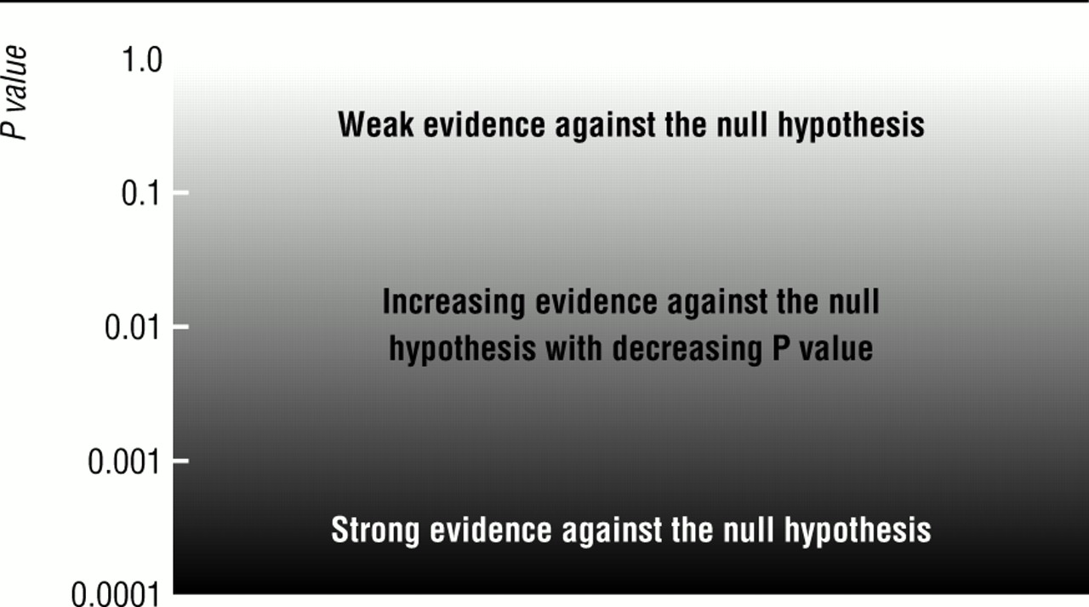
Rule 7. Be cautious with interpretations of statistical significance
Judge p-values on a sliding scale and in context
doi: https://doi.org/10.1136/bmj.322.7280.226 (

Slide 22

Rule 8. Make your research open
Open research is more credible and increases the value of research
More scrutiny is a good thing
Allows others to build on your work
Share code on GitHub; really useful for you
Photo by Jan Tinneberg on Unsplash

Slide 23
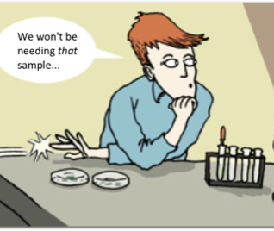
Rule 9. Report all findings
Experiments that failed or that did not provide the expected result are still important
Called the “file drawer” effect

Slide 24
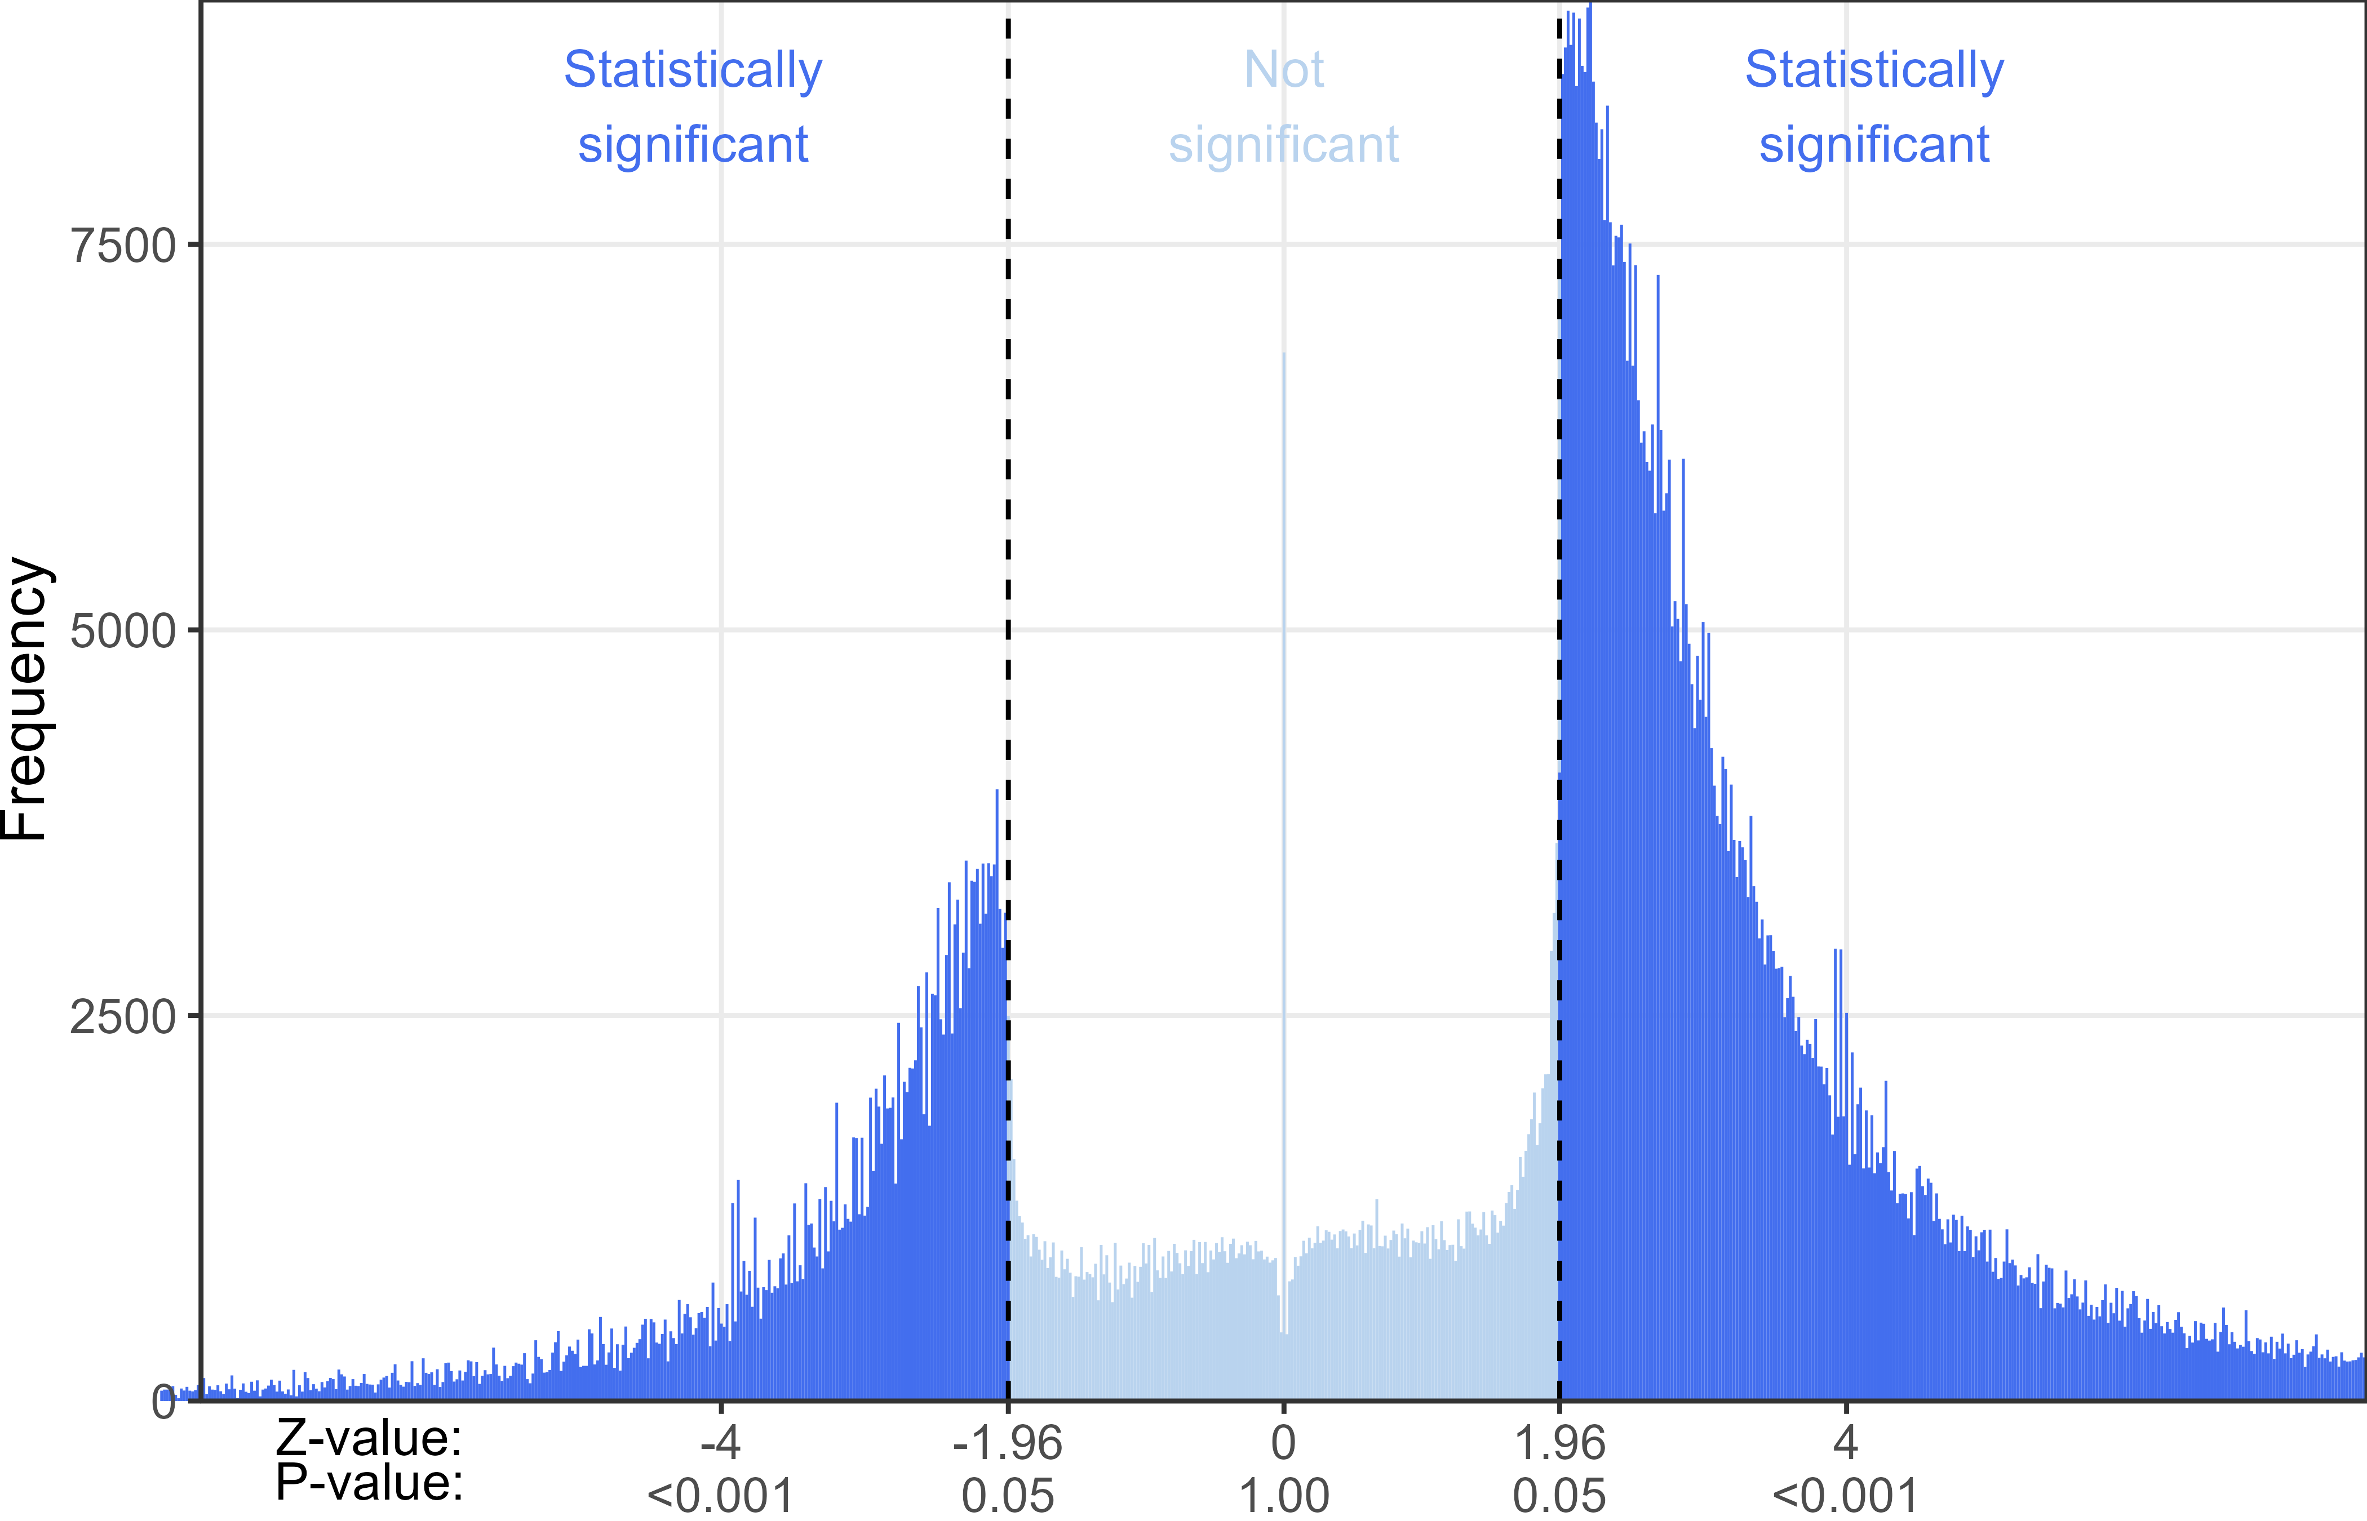
Rule 9. Report all findings

Slide 25
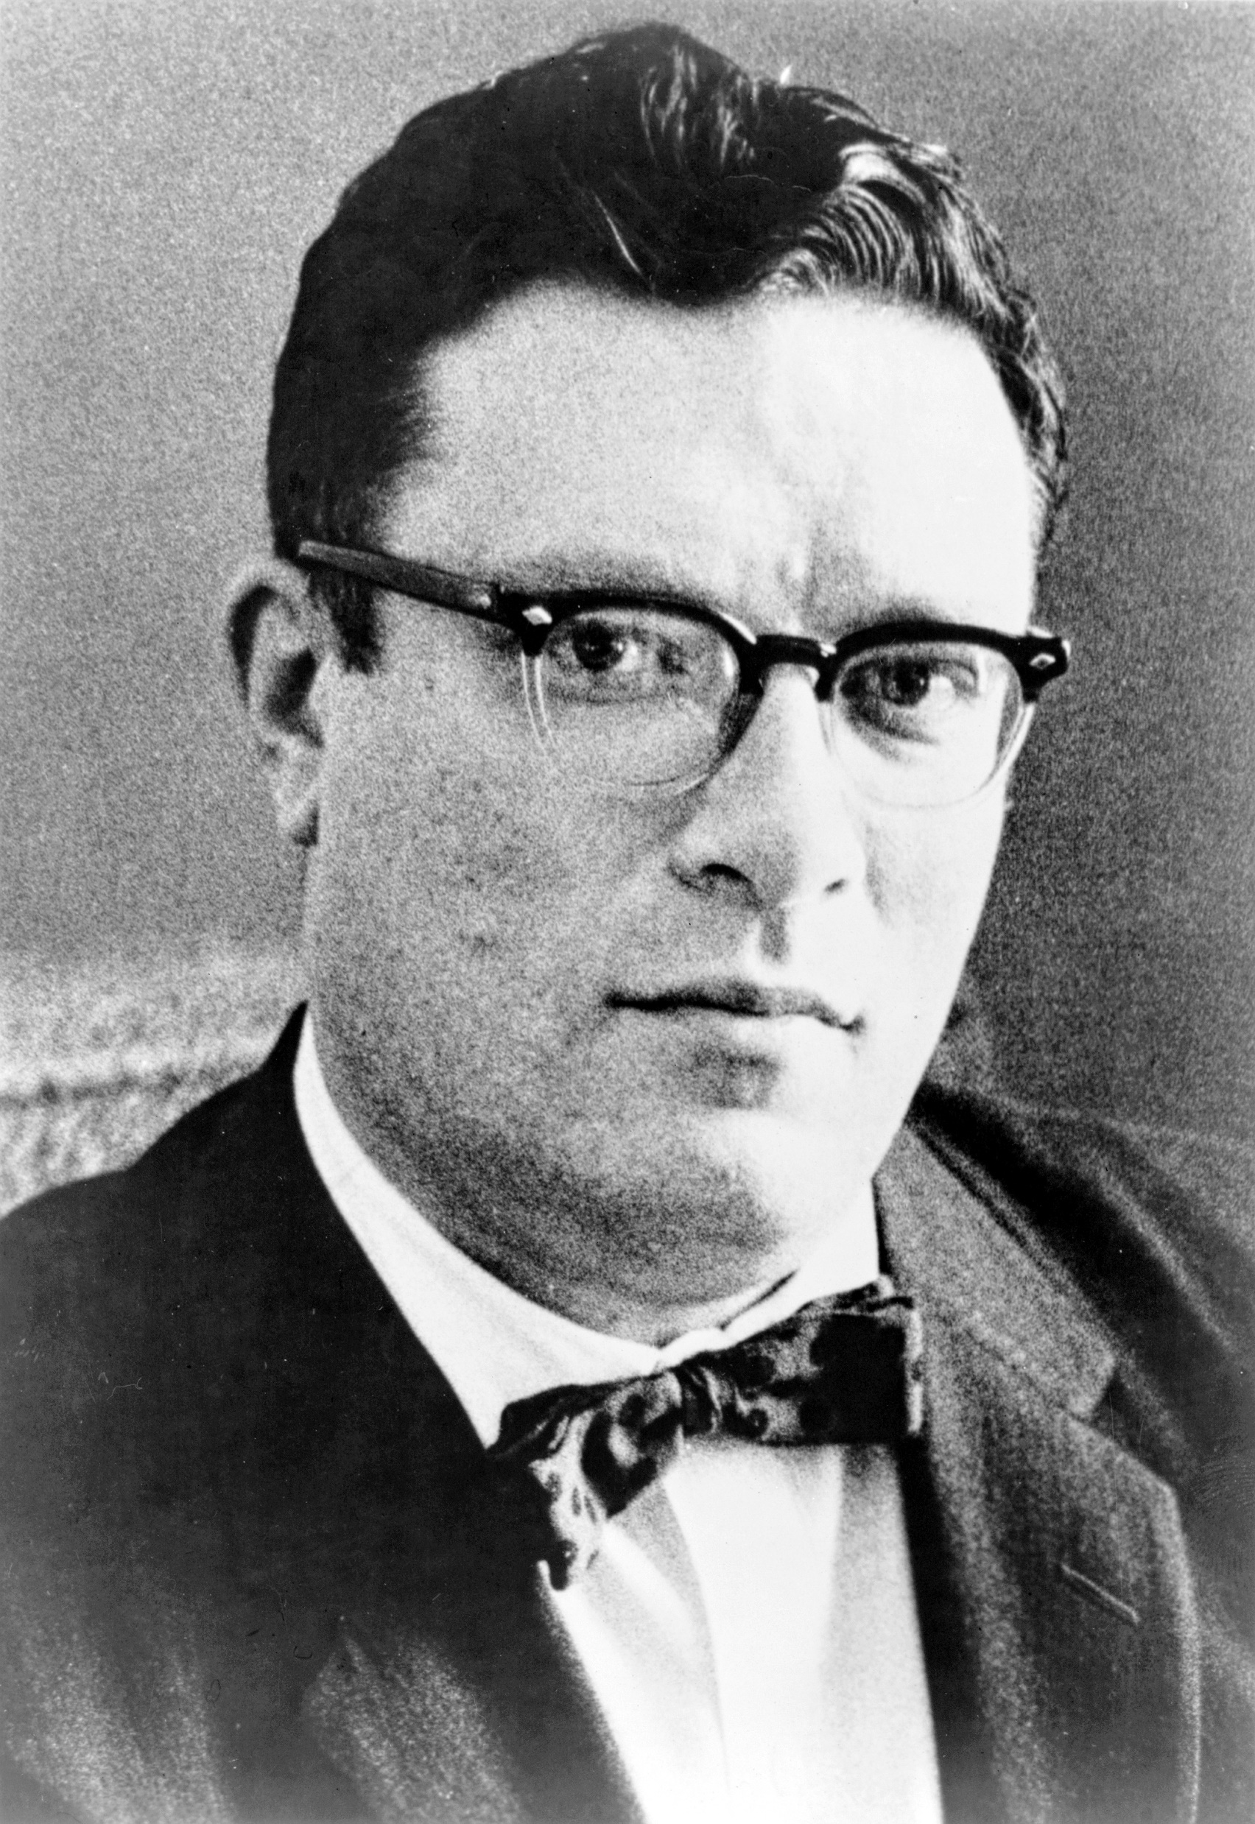
Rule 9. Report all findings
The most exciting phrase to hear in science, the one that heralds new discoveries, is not “Eureka” but “That’s funny”, Isaac Asimov
Phillip Leonian from New York World-Telegram & Sun, Public domain, via Wikimedia Commons

Slide 26
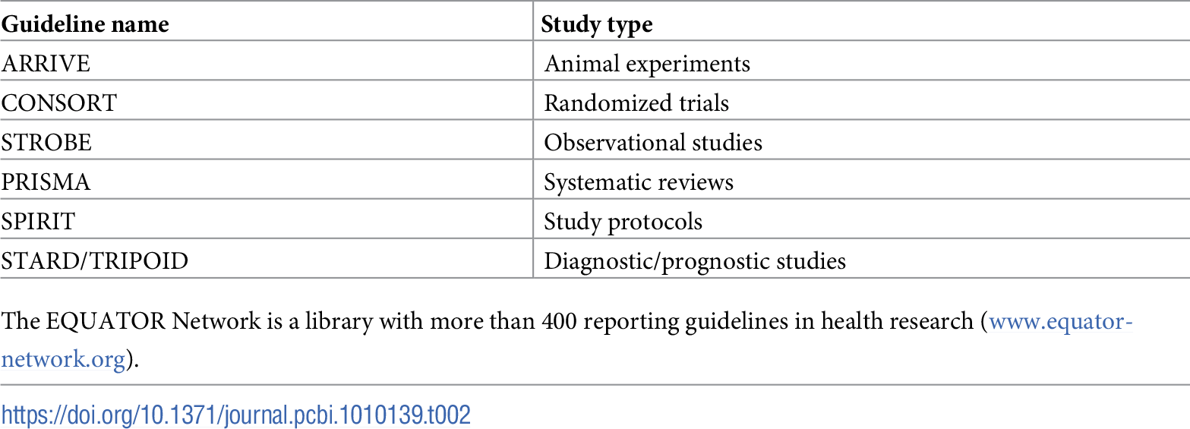
Rule 10. Follow reporting guidelines

Slide 27

Overarching goals
Following these 10 rules will immediately put you in the top 10% of scientists on quality
Slow science: Quality over quantity
Think more, plan more
Have humility https://doi.org/10.1038/s41562-021-01203-8
Photo by david clarke on Unsplash

